Slide 1
Model Monitoring
Pravin Y Pawar
Adapted from “What is Model Monitoring?”

Slide 2
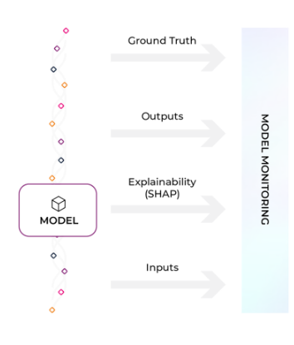
What is Model Monitoring?
A series of techniques used to detect and measure issues that arise with machine learning models
Once configured, monitors fire when a model metric crosses a threshold
Areas of focus for monitoring include
model performance,
data quality,
drift detection
and embedding analysis

Slide 3
Why Is Model Monitoring Important?
A lot can go wrong with a production model
navigating model issues can be challenging for even the most seasoned machine learning (ML) practitioner
With model monitoring,
can immediately know when issues arise in machine learning models
better insights empower data scientists and ML engineers to pinpoint where to begin further analysis
Model Monitoring Improves Business Outcomes
Despite the multitude of problems a model can encounter in the real world,
over half of ML teams lack a reliable way to proactively surface when something is going wrong with a model in production
Many rely on
batch in-house solutions or dashboards that may not catch issues in time
tools that are not purpose-built for machine learning
In an era where ML models relied on to increase profitability and even save lives, it’s clear that better model
monitoring is critical.

Slide 4
Model Performance Management
Model performance indicates how model performs in production
Measure model performance with an evaluation metric,
which can be evaluated with daily or hourly checks
on metrics such as accuracy, recall, precision, F1, MAE, MAPE, and more
model type directs which performance metrics are applicable to model
Performance monitor recommendations:
Performance monitors measure performance based on an evaluation metric
Can use performance metrics to compare model behavior between different environments
Use those insights to drill into the root cause of performance degradation
Important to look at the performance of models across various cohorts and slices of predictions

Slide 5
Drift Monitoring
Drift monitors measure distribution drift, which is the difference between two statistical distributions
Models are trained with polished data to represent production environments
it’s common for real-world production data to deviate from training parameters over time
need to measure drift to identify if models have grown stale, have data quality issues, or if there are adversarial inputs in model
Drift monitor recommendations:
To detect drift over time, set baseline using training data to identify how model changes between features, predictions, and actuals
To detect short-term drift, set baseline using historical production data (i.e. two weeks).
With proactive monitoring, detecting drift should be easy with automatic alerts
Bulk-create monitors with multiple baselines, view feature performance at a glance, access a historical view of drift,
and access the distribution view associated with drift metric

Slide 6
Data Quality Monitoring
ML models rely on upstream data to train and make predictions
Data is commonly collected from multiple systems, vendors, or can be owned by another team,
making it difficult to ensure always have high-quality data
Model health depends on high-quality data that powers model features!
Important to immediately surface data quality issues to identify how data quality maps to model’s performance
Data quality monitors help identify key data quality issues
such as cardinality shifts, data type mismatch, missing data, and more
Data quality monitor recommendations:
Use data quality monitors to detect shifts in upstream data and alert underlying changes
Configure data quality monitors to detect data issues like change in cardinality and change in percent of missing values

Slide 7
Monitoring Unstructured Data
Most companies building computer vision (CV) or natural language processing (NLP) models lack a window into their models
are performing in production, running the risk of models impacting earnings or acting in unfair ways
Since deep learning models rely on human labeling teams,
identifying new patterns in production and troubleshooting performance can be tricky
CV and NLP Model Monitoring Recommendations:
Visualizing and monitoring embeddings — vector representations of data where linear distances capture structure
By monitoring embeddings, ML teams can proactively identify when their unstructured data is drifting

Slide 8
Thank You!
In our next session:

